Slide 1
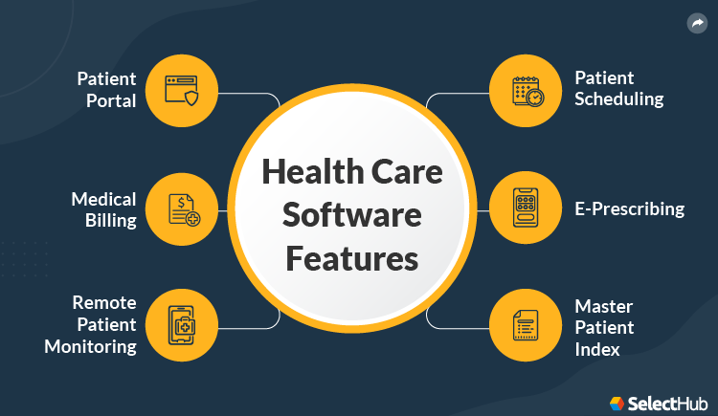

The Smart Healthcare System is designed to improve healthcare services by
providing an integrated platform for hospital bed availability, detailed doctor
analysis, secure patient history management, and fundraising support for needy
patients. This innovative approach leverages modern web technologies to solve
existing problems in healthcare, providing a seamless experience for patients,
hospitals, and donors alike.
The use of real-time data, user-friendly interfaces, and scalable cloud-based
deployment will make this system a valuable addition to the healthcare industry.
With its comprehensive features, this project stands out as an all-in-one
healthcare platform aimed at improving accessibility and transparency in Health Care

Slide 2

Project Objective
1. Check real-time bed availability in hospitals within a specified city.
2. View detailed information about doctors, including their experience,
number of operations performed, and their success rates.
3. Access patient medical history, which includes medication details and
known allergies, using their Aadhar card number for verification.
4. List financially distressed patients for fundraising, allowing donors to
contribute to their treatment.

Slide 3
User Types and Roles
Admin
Workers
Customers
Hospital Administration for managing the resources and doctors
Doctor and nurses have to prepare the records of patient
Patients and there family

Slide 4

User Registration Process
1
Account Creation
Users provide basic information and choose their account type ( patient /ambulance deiver/health care worker
2
ID Verification
Upload government-issued ID for identity verification and enhanced security.
3
Profile Completion
Add detailed information, Health issue

Slide 5

Patient Profile
Sure! Here’s a condensed version of patient details for a hospital management system:
Basic Information
1. **Patient ID**
2. **Full Name**
3. **Date of Birth**
4. **Gender**
5. **Contact Info** (phone, email)
6. **Address**
Medical History
7. **Allergies**
8. **Chronic Conditions**
9. **Previous Surgeries**
10. **Current Medications**

